Slide 1

Group 7
Project 1 : NYT+TMDb review discovery app

Slide 2
Why this?
The reasoning behind our project

Slide 3
Concept breakdown
One page Browser application
We’re into films and always up to find new titles
Aggregate score and review sites can be overwhelming
As film fans, we want to find highly professional and well regarded reviews
So that we can decide if a film is worth watching
Group 7 - November 19 2020

Slide 4
Our process
Api selection and key requests
Movie reviews api (https://developer.nytimes.com/docs/movie-reviews-api/1/overview)
Tmdb api (https://developers.themoviedb.org/3/getting-started/introduction)
Framework selection and documentation review
Bulma css (https://bulma.io/documentation/overview/start/)
jQuery (https://api.jquery.com/)
Tasks delegation
Create repo and begin the project
Group 7 - November 19 2020

Slide 5
How did we fare?
Challenges
Getting used to git
Dealing with code reviews and conflict resolution
Making it all work
Local storage for images
Successes
Landing on the general app look and feel early on
Keeping the page clean
Few conflicts in git overall
Group 7 - November 19 2020

Slide 6
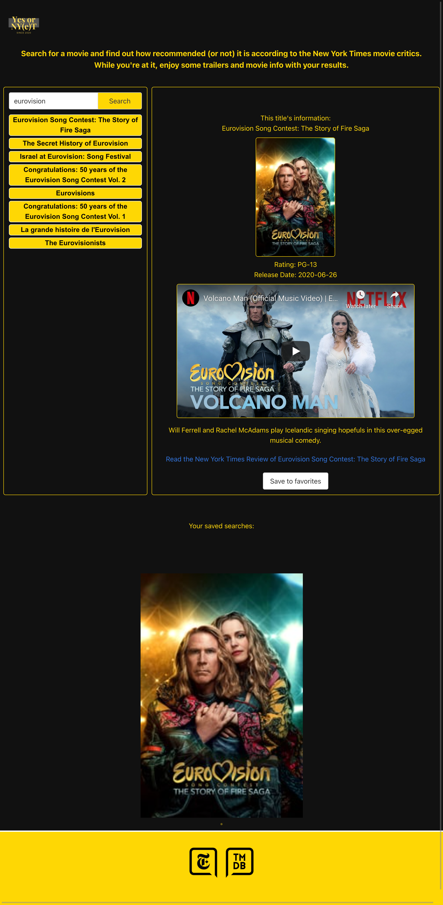
Demo time:
https://uoft-group7-project-1.github.io/Group7_Project-1/

Slide 7
Directions for future development
Project 1
Go through the API response data and add more movie information to enrich the content displayed
Keep the page look simple while adding content
Test different frameworks to identify potential improvements to responsive item handling
Group 7 - November 19 2020

Slide 8
Links
https://github.com/UofT-Group7-Project-1/Group7_Project-1
https://uoft-group7-project-1.github.io/Group7_Project-1/
Group 7 - November 19 2020

